Slide 1




Cook it yourself

Slide 2

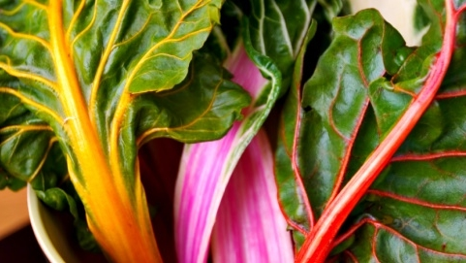

agenda
Weekly progress
Next steps
project progress

Slide 3
Weekly progress
Add tests to CI/CD
Add step by step recipes
Cut videos to steps
Implement feedbacks

Slide 4
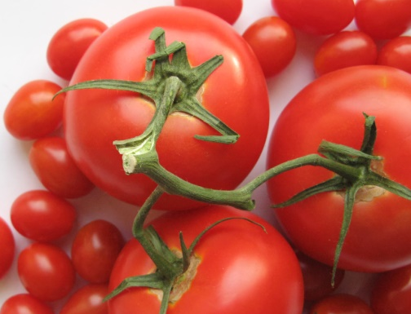
Next steps
Prepare for final demo
Finish CI/CD pipeline

Slide 5
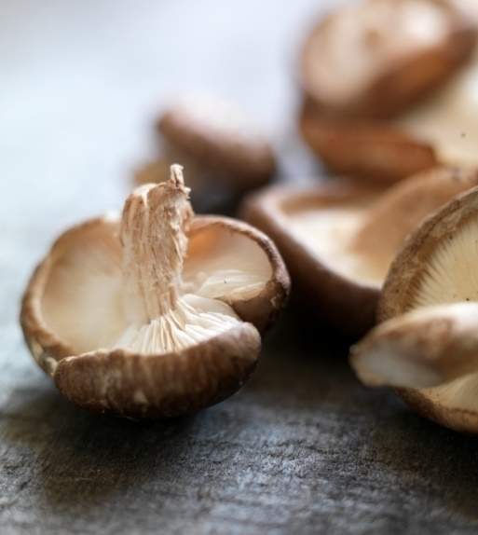
project progress

Slide 6
Thank you

